Slide 1

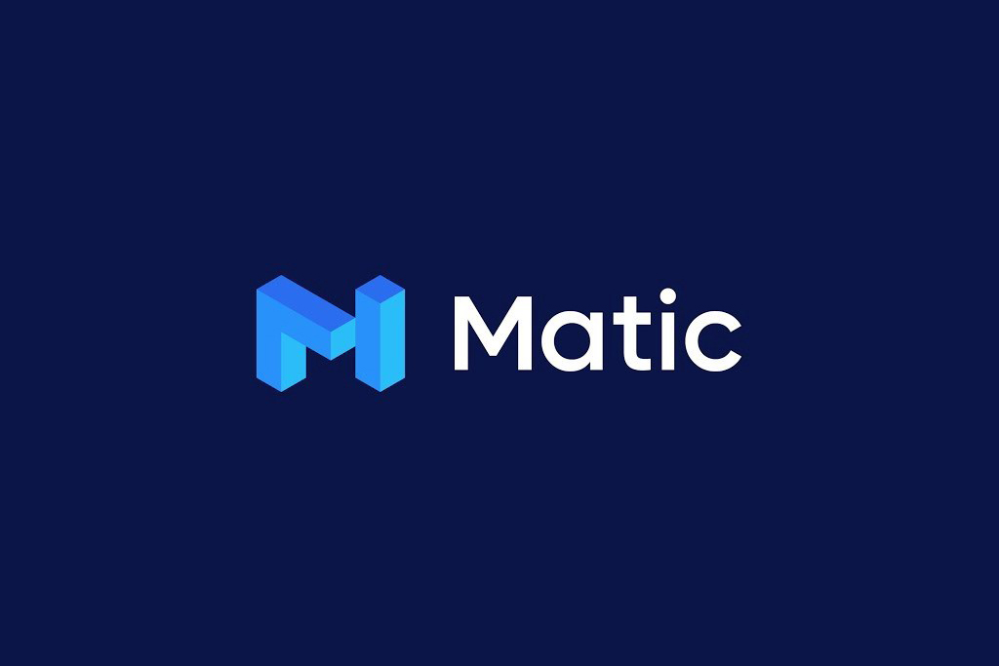
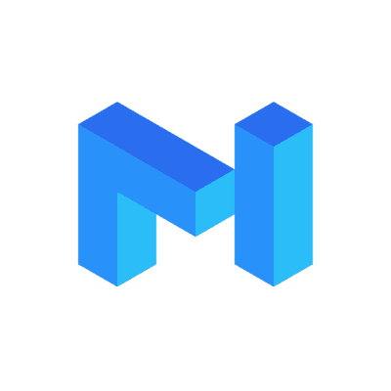
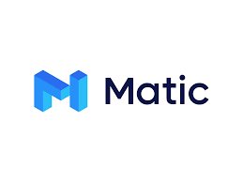
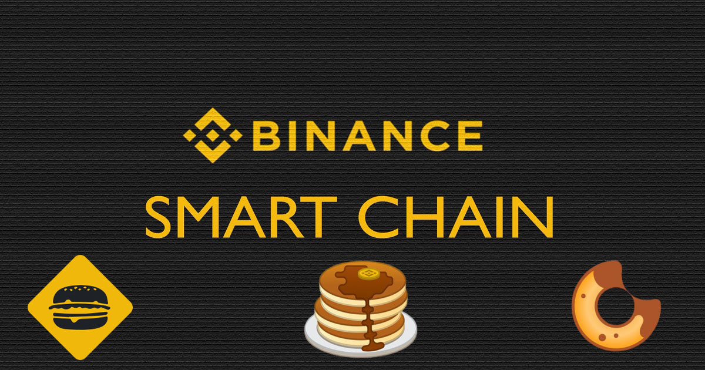
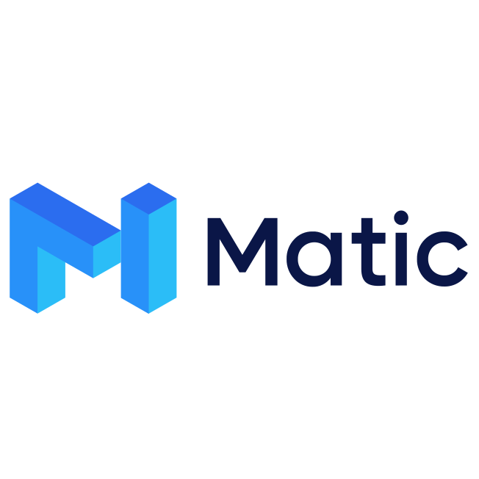
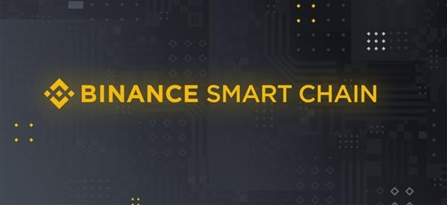
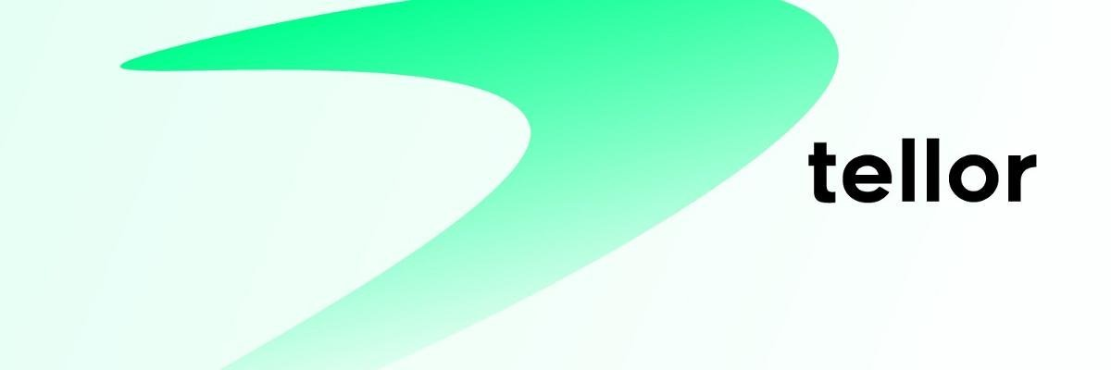
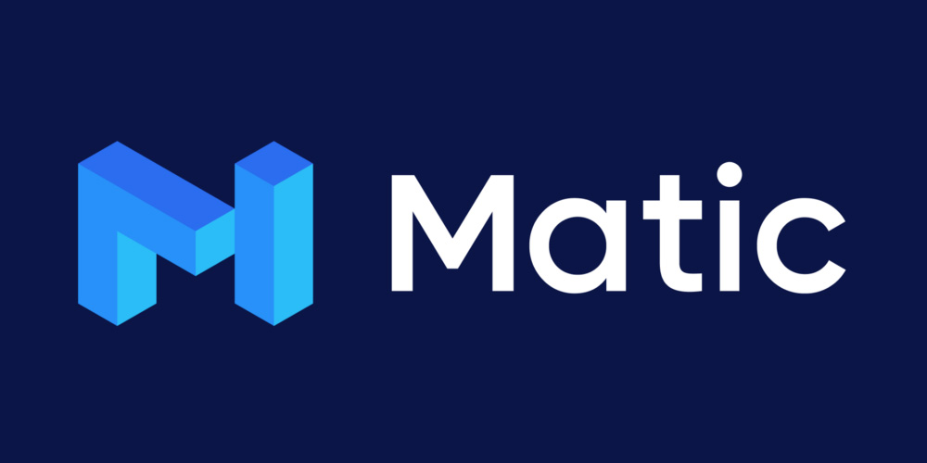


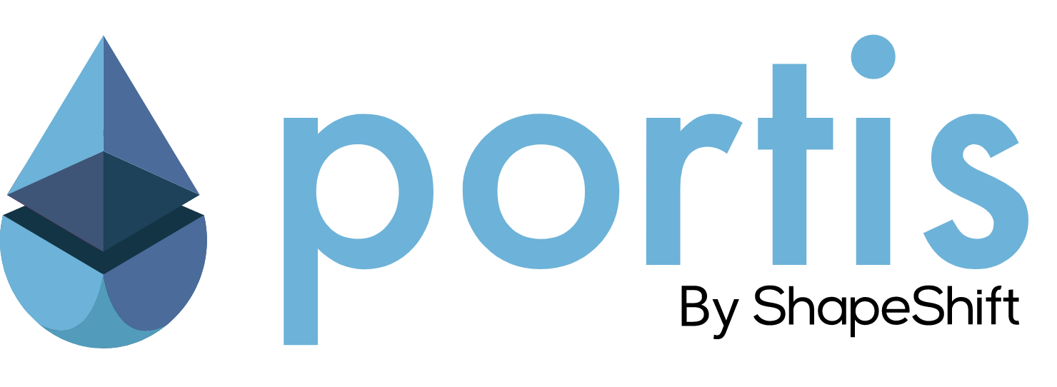
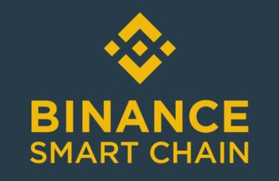
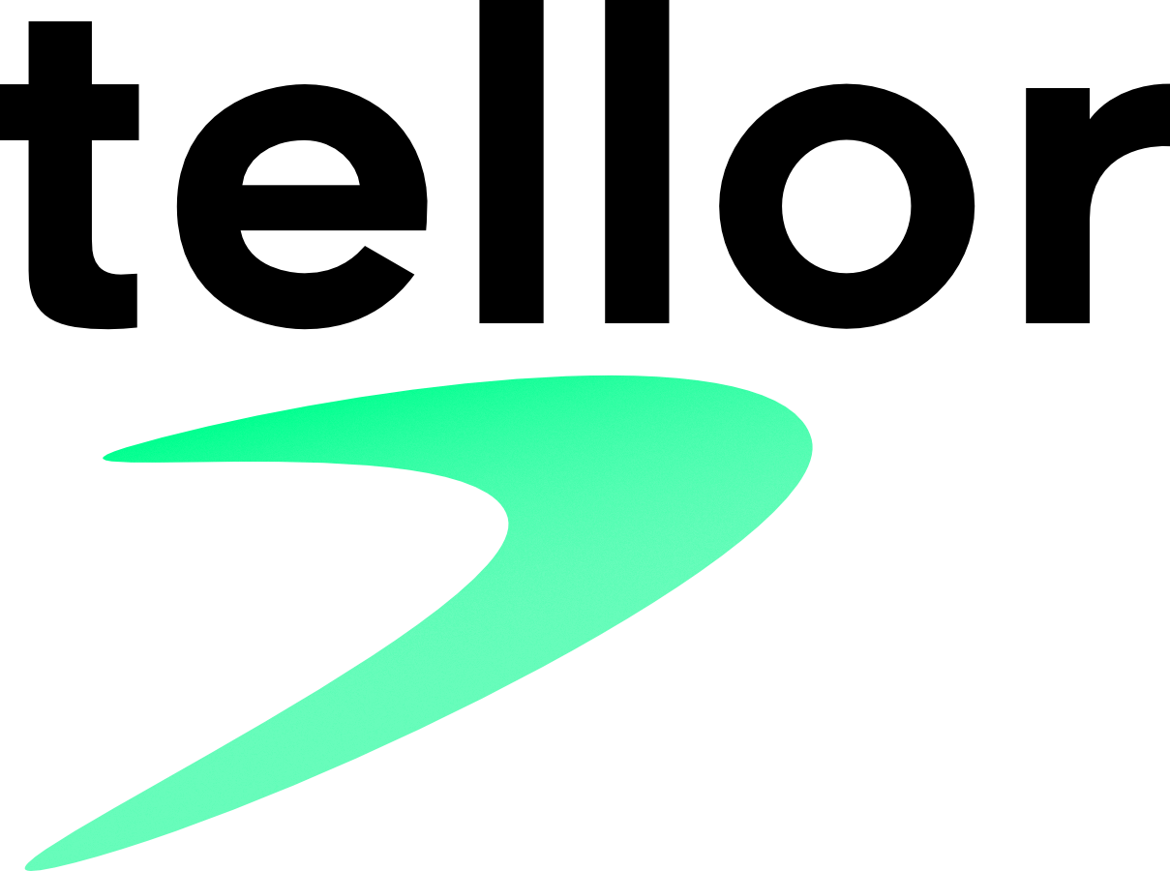
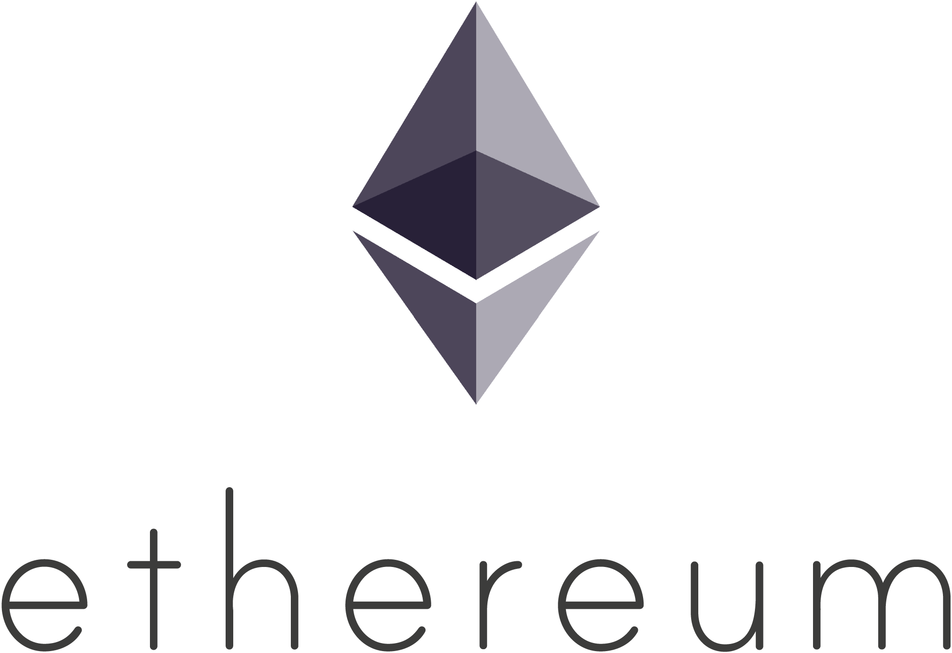
Pool 2 Play
A X-Chain Subscription Mechanism
Notes:
Hey !
I’m going to present Pool 2 Play, a concept for a cross-chain subscription mechanism.

Slide 2
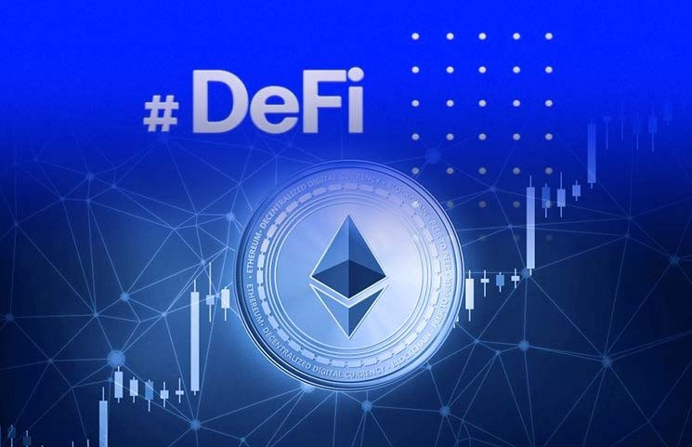

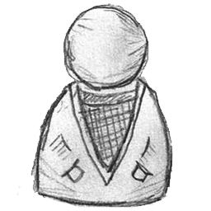
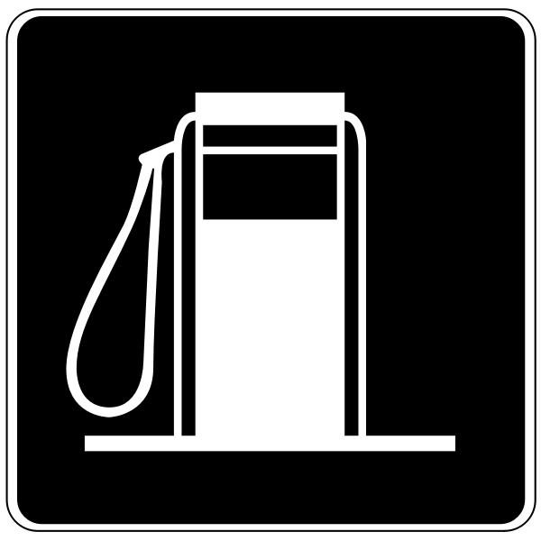
Pool 2 Play
invest
Pool Contract
L
L
Stake
NOK
Check?
OK
L
Unstake
L
Tx
Player
L
Fees
Game Contract
L
Signed Tx
Relayed Tx
L
Fees
L
Gas Relay
yield
Notes:
First let me explain where does this idea come from.
In some past hackathons, I have built decentralized games.
To provide a seamless connection experience for the players I wanted to use a Gas relay to avoid them having to pay fees for each transaction.
Inspired by the PoolTogether Dapp, I have imagined a subscription mechanism where:
A player needs to stake in a pool a small amount of tokens.
As long as the stake is held, the player is allowed to play.
In the meanwhile the pool of tokens staked by all players is invested in DeFi in order to generate interests.
The pool(s profits are used to supply the gas relay and so pay fees for the transactions issued during the games.
When a plyer gets his stake back, he’s not allowed to play anymore.

Slide 3
Pool 2 Play
Blockchain X
invest
Pool Contract
?
Blockchain Y
Game Contract
Notes:
Getting deeper in this idea, I’ve met the following issue:
For the game, I need to use a blockchain very fast and cheap (a layer 2 for instance). Ethereum Mainnet doesn’t fit.
For the pool mechanism, in order to optimize the yield, I would better use a blockchain with lots of DeFi opportunities. And Ethereum Mainnet is currently the best choice.
So, I need a way for my game contracts to check whether a player has contributed to the pool or not, knowing that the game and the pool are deployed on 2 separate blockchains.
Can I use a decentralized oracle mechanism ?

Slide 4
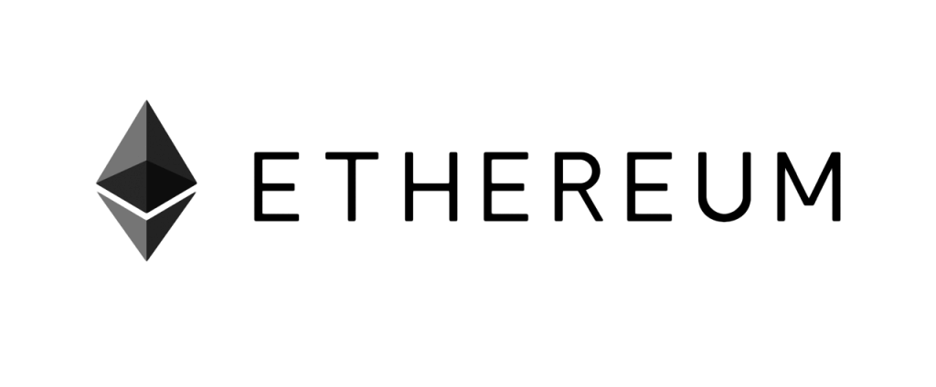
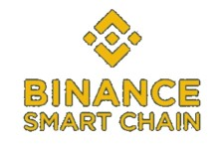
Decentralized Oracle
ERC20 Contract
balanceOf()
Miner
submitValue()
Game Contract
Oracle Contract
Notes:
I looked at the Tellor protocol and I found that with the proper improvements, this could be used to request a value from one blockchain to another.
In the following demonstration, the GameMaster smart contract deployed on Binance Smart Chain testnet Is using a Tellor Oracle to get the balance of an account for a given ERC20 contract deployed on Ethereum Goerli
If the balance is positive then the player is allowed to play, otherwise he’s not.
Let me show you.

Slide 5
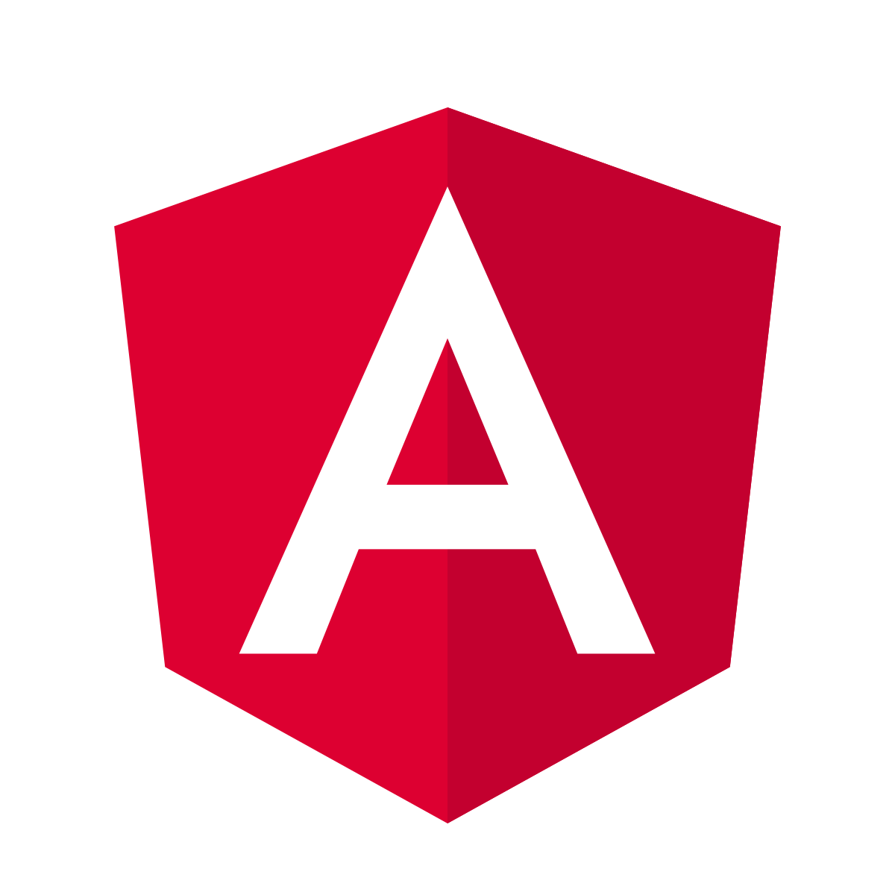
Player
DAPP Front-end
Game Contract
Oracle Contract
Miner
ERC20 Contract
register
register
getCurrentValue
Registration Pending
No value or out-of-date
addTip
TipAdded
getRequestParams
@token, account
Connect @token
balanceOf (account)
NewValue
submitValue
balance
register
getCurrentValue
Registered
Registration Granted
?
up-to-date value
check
Notes:
Before going further with the demo, let me explain what happened.
When the player clicks on Register on the DAP Front-end, a transaction ‘register’ is sent to the Game Contract.
The game contract contacts the Oracle contract to get the current value of the player subscription
If no value is returned or the returned value is out-of-date, the registration is set to pending and the Oracle contract is called again with addTip method.
An event TipAdded is then caprtured by the Tellor network
The Tellor miner then get the parameters of the requests (the address of the token contract and the player account)
It connects the token contract on the other blockchain and call the method balanceOf for the player account
Finally, it returns the balance value calling back the Oracle contract
A New Value event is captured by the DAPP, which calls the GameMaster again to update the registration status.
The Game Contract calls the Oracle to get the up-to-date value, checks it and grant the registration accordingly

Slide 6

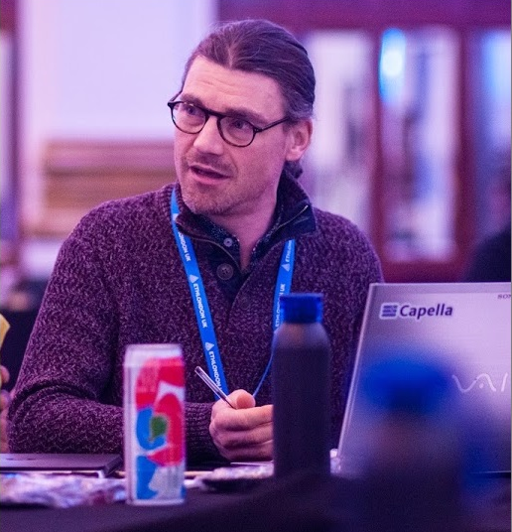
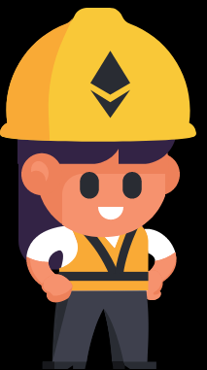
Thank You!
The BuiDLer: Ludovic LEVALLEUX
https://www.linkedin.com/in/ludovic-levalleux
Notes:
I hope you’ve enjoyed this presentation.
Please let me get your feedbacks.
Thank you

